Slide 1
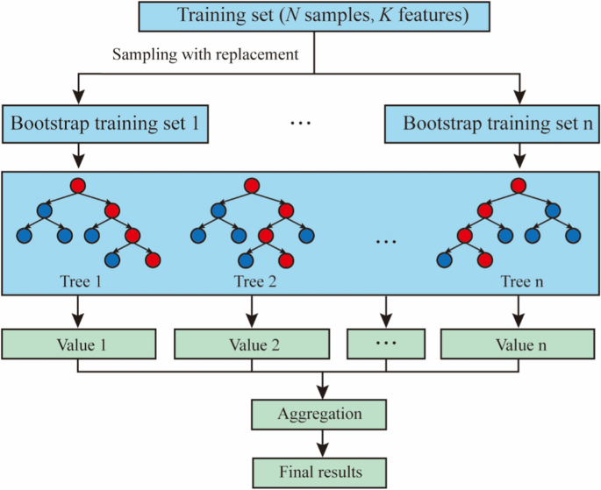
Random Forest

Slide 2
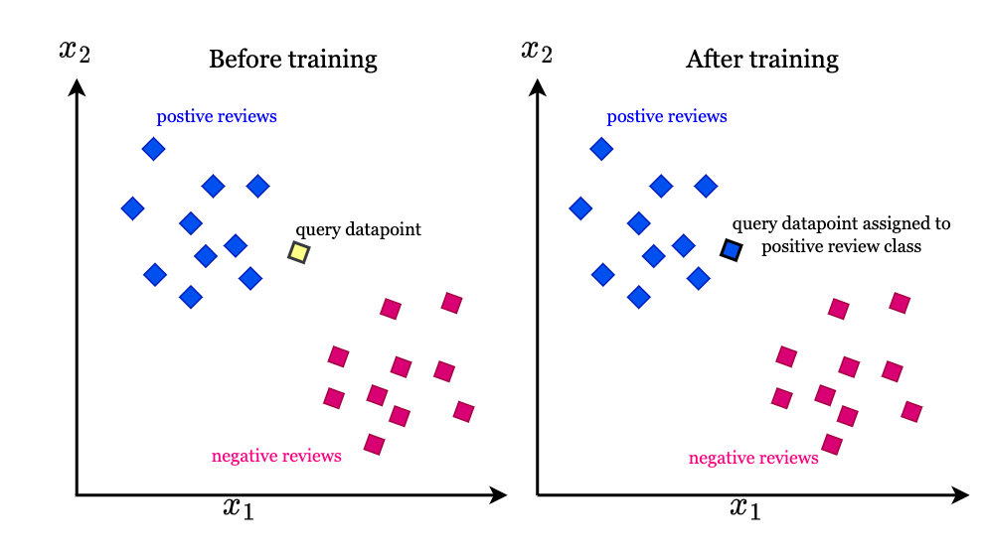
KNN

Slide 3
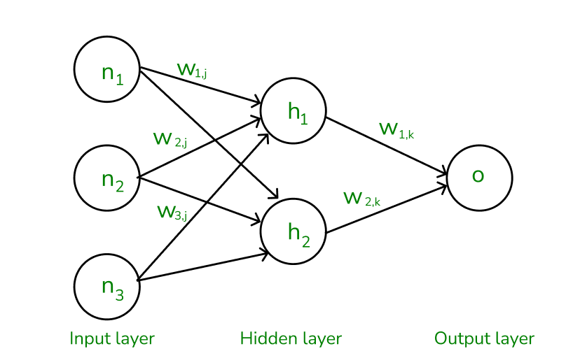
Back Propagation

Slide 4
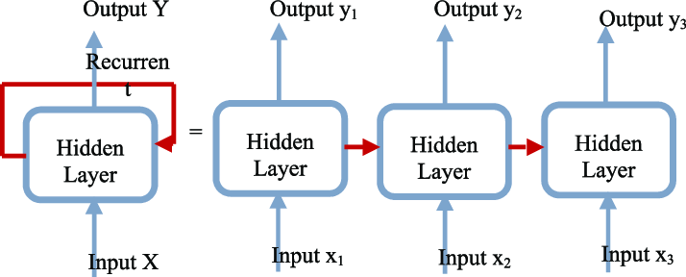
RNN

Slide 5
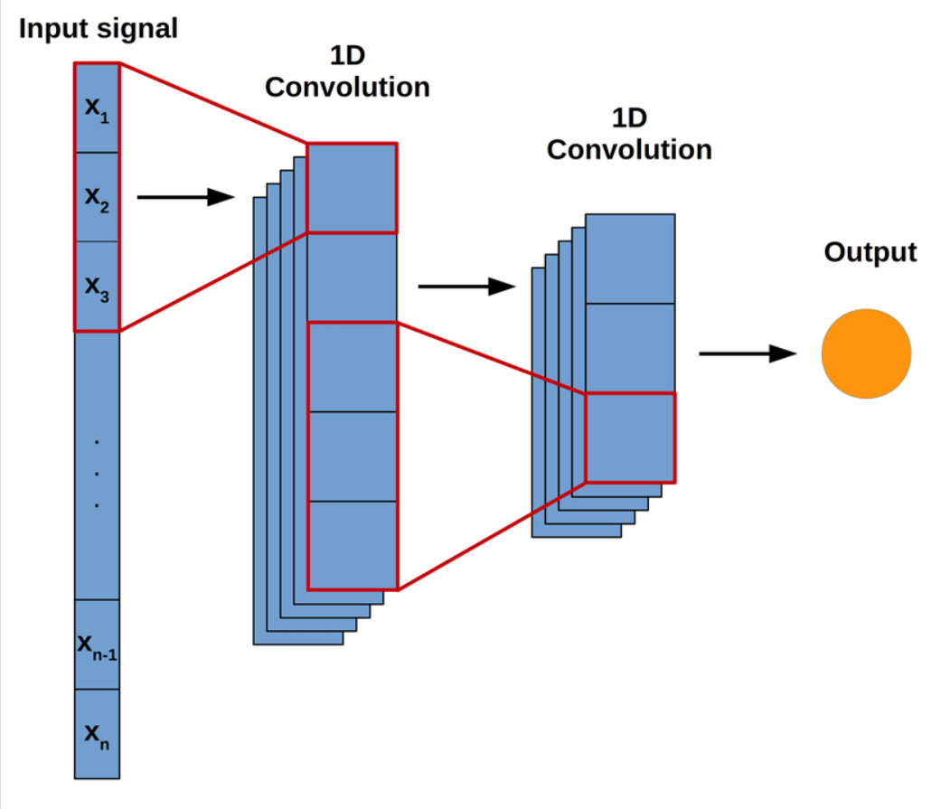
1D CNN

Slide 6
Performances
Accuracy
Precision
Recall
F1 Score

Slide 7
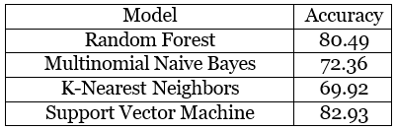
Accuracy of ML Models

Slide 8
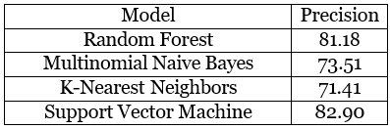
Precision of ML Models

Slide 9
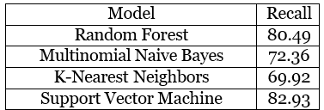
Recall of ML Models

Slide 10
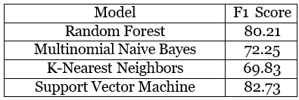
F1 Score of ML Models

Slide 11
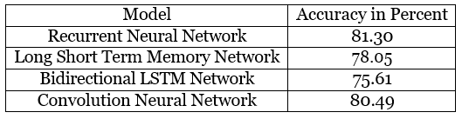
Accuracy of DL Models

Slide 12
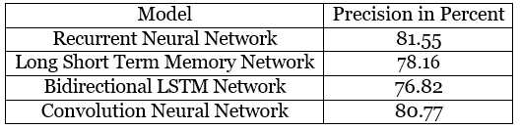
Precision of DL Models

Slide 13
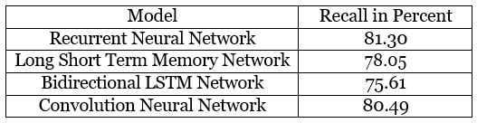
Recall of DL Models

Slide 14
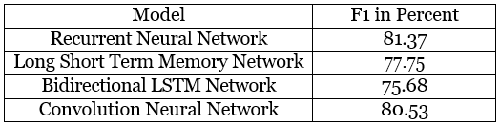
F1 Score of DL Models

